Slide 1
Current Depression and Suicide Issues:
An Unhealthy Alliance.
Kitson Francis. Ph.D.

Slide 2
We will begin by taking a general look at depression
Then look at suicide
Then look at the relationship between depression and suicide
Then close out by looking at Nigeria

Slide 3
Objectives of this Presentation
Participants will come to :
Have an understanding of depression
Have an understanding of Suicide
Have an understanding of the relationship between depression and suicide
Have an understanding of the need for appropriate intervention

Slide 4
Depression: A mood disorder AKA affective disorder.
The phrase “mood disorder” is used to describe a mental health conditions that impact a person’s emotional state of well-being.
Also known as affective disorders. It impacts approximately 21.4% adults in the United States at some point during their lives.

Slide 5
Types of Depressive Disorders:
Major depression MDD— typically lasts for at least two weeks and often longer than four weeks.
Seasonal affective disorder — occurs at certain times of the year, typically with a change of season.
Persistent depressive disorder — a long-term form of depression that causes feelings of sadness, emptiness and often hopelessness.

Slide 6
Types of Depressive Disorders Cont’d:
Disruptive mood dysregulation disorder — a diagnosis used for children and teenagers. It features constant, serious and lasting testiness with frequent temper outbursts that are not consistent with the age of the child.
Premenstrual dysphoric disorder — features mood changes, hopelessness and feelings of being overwhelmed or out of control. These symptoms occur in the 10 days before a menstrual period and go away within a few days after a period begins.

Slide 7
Types of Depressive Disorders Cont’d:
Depression related to a medical condition — features a great loss of pleasure in most or all activities due to the physical effects of another medical health problem.
Depression related to substance or medicine use — features depression symptoms that start during or soon after using a street drug or medicine, or after withdrawal from these substances.

Slide 8
Symptoms of Depression
Make you feel:
Anxious
Cranky
Emptiness
Worthlessness
Helplessness
Hopelessness

Slide 9
Symptoms of Depression Cont’d
Guilty
Diet eat and sleep
Diet/eating
Sleep
Low Energy

Slide 10
Bipolar Disorder:
Bipolar disorders feature mood swings that include emotional highs called manic or hypomanic episodes, and lows, called depressive episodes.
These highs and lows are usually continuous. But they also can change from high to low or low to high or shift into a normal mood
Sometimes both the highs and lows might occur together. This is called a mixed episode. You could be easily distracted and have racing thoughts. Your sleep also could be affected

Slide 11
Bipolar Disorder Cont’d
Bipolar I disorder — features a constantly elevated mood that lasts for at least one week. This is called a manic episode. It affects your overall ability to function and more likely you'll take part in risky behavior.
Bipolar II disorder — features constantly elevated moods — called hypomania — that last at least four days and less than one week. There may be risky behaviors.
Mood disorders are more common in females.

Slide 12
Having a mood disorder may raise your risk of suicide.

Slide 13
Suicide: A Lethal abuse against society
As stated, depression has a positive correlation with suicide
Suicidality is a major global health problem. It is estimated that there are approximately 800,000 people per year who die by suicide.
It is estimate that around one suicide death occurs every 40 seconds globally
Suicide is ranked as the 12th leading cause of death among people aged 10 to 34 and the tenth among all age groups
Suicide is responsible for more deaths than malaria, HIV/AIDS, breast cancer, homicide and some wars

Slide 14
Suicide Spectrum
Suicidal ideation (SI).
Suicide plan (SP):
Suicide attempt (SA):
Completed suicide (CS)
One way to minimize the occurrence of all levels of suicide Is to recognize and understand general and specific pattern of thoughts and behavior on the emotional experiential continuum.
A person who has at least one failed earnest suicide attempt, is a prime candidate for repeat attempts.

Slide 15
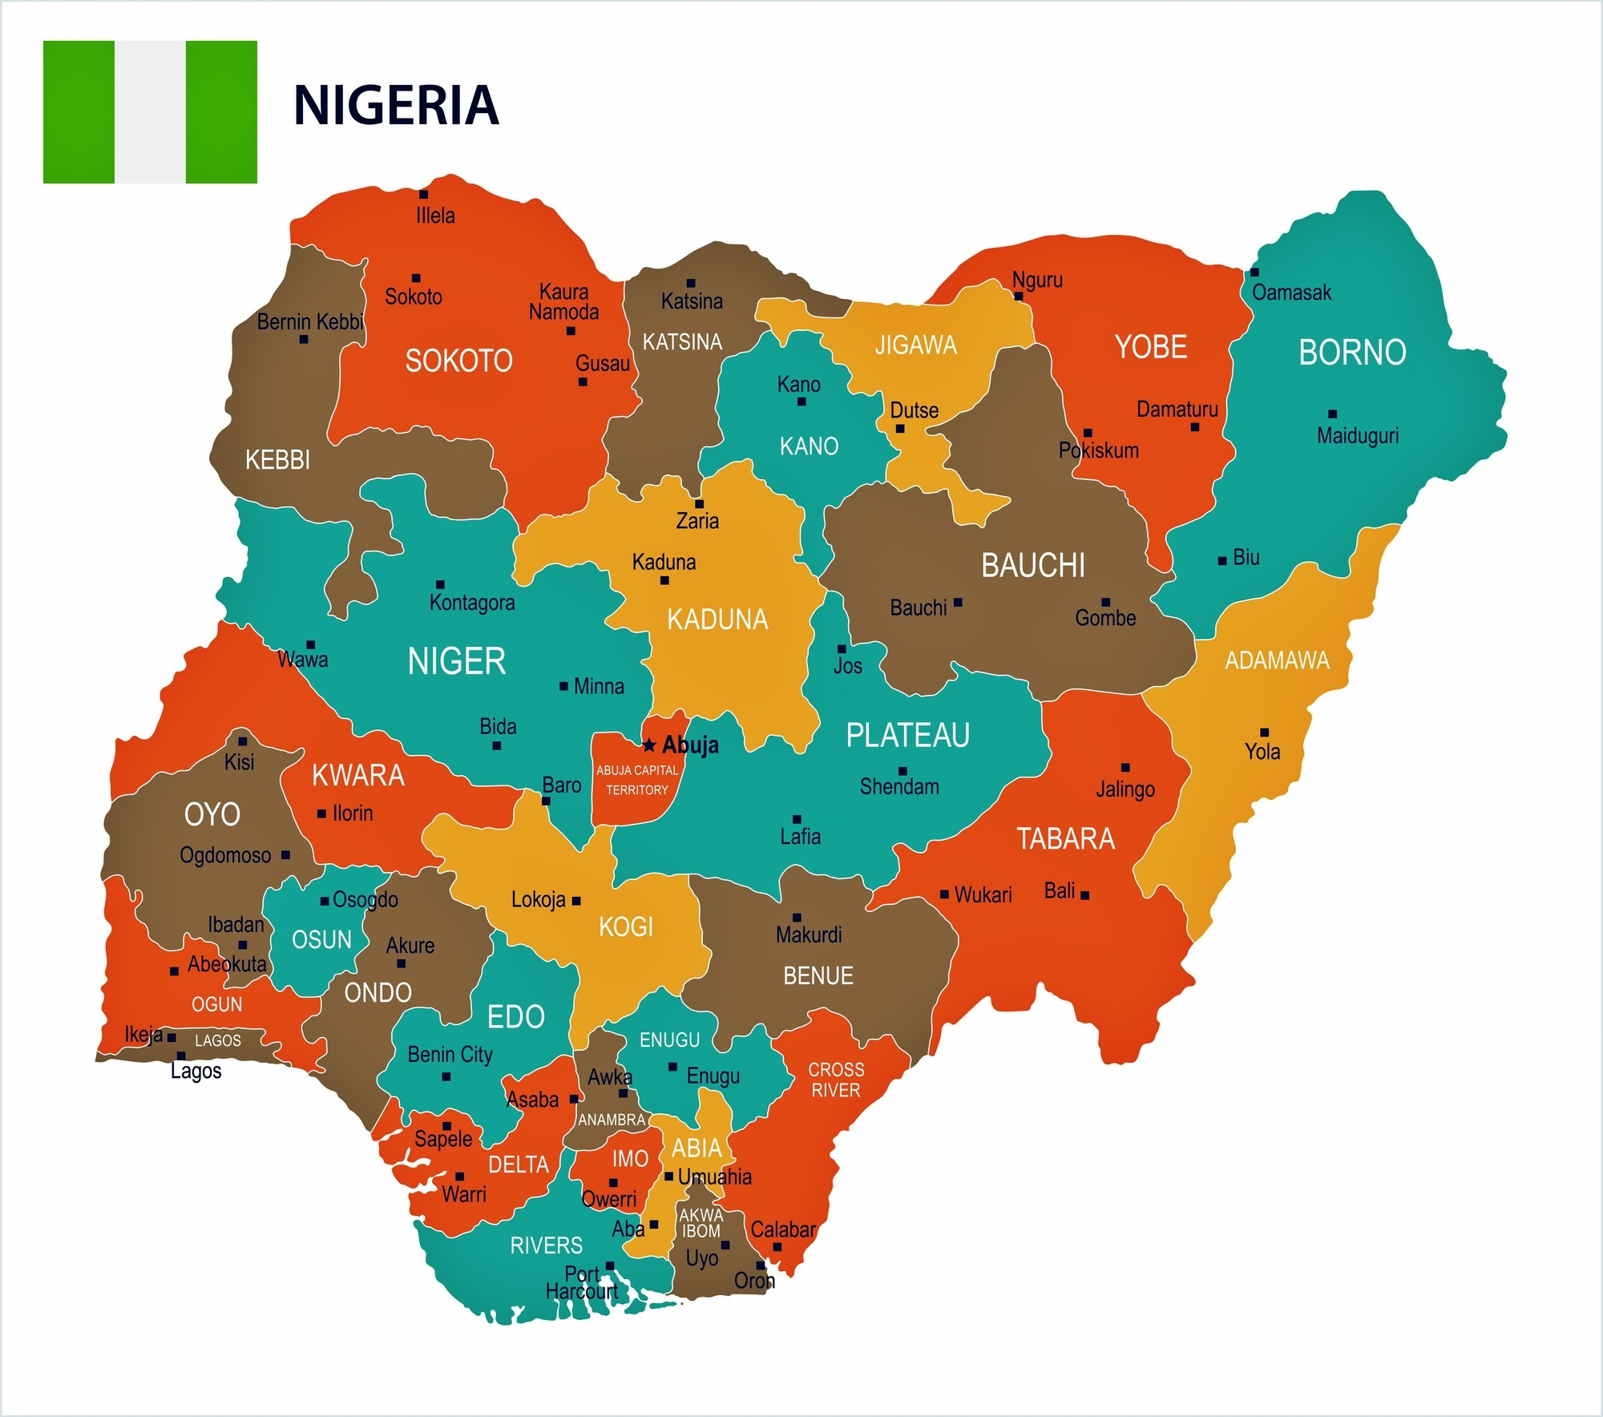
Nigeria

Slide 16
Nigerian Depression and Suicide Picture
1 in 5 Nigerians suffer from long-term depression
Nigeria has the highest rate of suicide and depression in Africa.
The current rate of suicide in Nigeria is 9.50% out of 100, 000 people attempt or succeed at suicide annually (10%)
Some research suggests that these numbers represent an under reporting of facts

