Slide 1
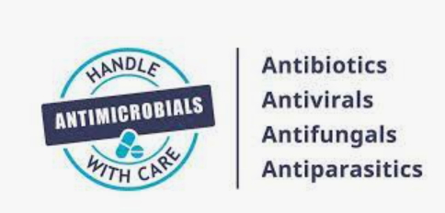
Notes:
World Antimicrobial Resistance Awareness Week

Slide 2
Different types of antimicrobials and the microorganisms they act on
Notes:
The term ‘antimicrobial’ refers to a substance that inhibits or destroys bacteria, parasites, viruses or fungi. The term antimicrobial also refers to medicines used to treat or prevent infections caused by bacteria, parasites, viruses or fungi. Antimicrobials fall into four categories:
Antibacterials (antibiotics)
Antifungals
Antivirals
Antiparasitics.
Antibiotics are a type of antimicrobial
Used when bacterial microbes are harmful to human health
Treat bacterial infections by targeting bacteria
They don’t cause harm to human cells or work on viruses
Can cause side effects, drug interactions, allergies and damage the good bacteria that we carry and need (microbiome)
Antibiotic: A compound that inhibits the growth or kills bacteria. In recent years, ‘antibiotic’ has become synonymous with ‘antibacterial’.
Antibacterial: A drug, chemical or other substance that kills bacteria (bactericidal) or stops their growth (bacteriostatic).
Antimicrobial: A drug, chemical or other substance that kills, inactivates or slows the growth of microbes, including bacteria, viruses, fungi and parasitesAntimicrobial: A drug, chemical or other substance that kills, inactivates or slows the growth of microbes, including bacteria, viruses, fungi and parasites.

Slide 3
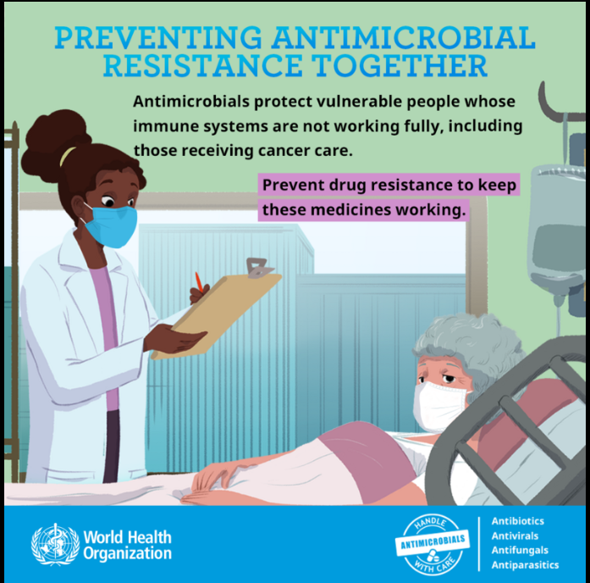
ANTIMICROBIAL AGENTS
The introduction of antibiotics revolutionized the practice of medicine and as such the health of man by making previously lethal infections readily treatable while cancer chemotherapy and organ transplantation possible.

Slide 4
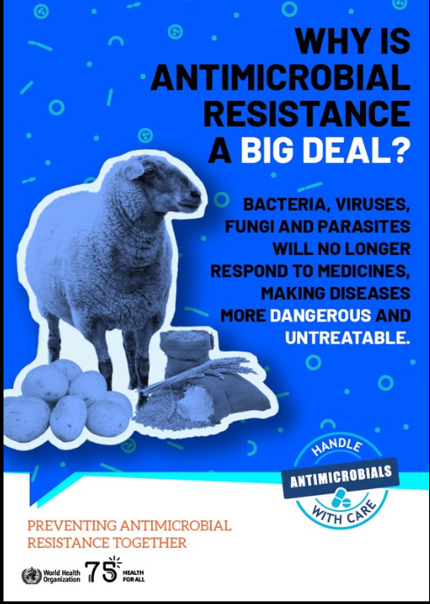
What is antimicrobial resistance?
Antimicrobial resistance (AMR) occurs when microorganisms change to protect themselves from the effects of antimicrobial drugs designed to destroy them.
This means previously effective antimicrobials used to treat or prevent infections may no longer work.

Slide 5
Why are antimicrobials and antimicrobial resistance important?
Modern medicine, especially surgery and cancer treatments, depends on effective antimicrobials to minimise the risk of infection
reduce post-operative infection rates to below 2%
Without effective antibiotics, this could increase to ~40% to 50%. Up to 30% could die from resistant bacterial infections
The risk of mortality without access to effective antibiotics may make some treatments and surgical procedures too risky to continue
https://www.vox.com/2014/12/12/7382299/new-report-drug-resistant-infections-will-kill-more-people-than
Notes:
Consumers are aware that antibiotics treat infections. However, consumers may not be aware that antibiotics are essential in preventing infection after surgical procedures and for patients receiving chemotherapy.
Antimicrobial resistance has significant and direct implications on patient care. Antibiotics play an essential role in preventing infection after surgery. For example, people currently undergoing surgery procedures (such as hip and knee replacements) receive standard prophylactic antibiotics and currently experience infection rates of around 0.5-2.0%. If access to effective antibiotics were reduced through antimicrobial resistance, post-operative infection rates could rise to around 40-50%, and up to 30% of these patients could die from these infections.
Antimicrobial resistance also impacts on a range of treatment options, such as chemotherapy for cancer patients, which may no longer be a viable or safe option due to the increased risk of complications and infections resulting post treatment. This reduction in safe and viable treatments, and services able to be offered by health facilities, would have a negative effect on the effectiveness of the healthcare system in the long term.
In 2014 the UK Government commissioned a review on antimicrobial resistance which investigated the global economic cost of infections caused by resistant bacteria. The work by KPMG and RAND Europe indicated that if the current trend of increasing antimicrobial resistance continues, by 2050 about 10 million people may die every year as a direct result of resistant bacterial infections for which there is no effective antimicrobial (which includes antibiotics). Gross domestic product would also decrease as a result of antimicrobial resistance, which the review indicated would translate to a reduction in global economic output worth between US$60 - US$100 trillion.
https://www.vox.com/2014/12/12/7382299/new-report-drug-resistant-infections-will-kill-more-people-than

Slide 6
Resistance is not new
https://www.businessinsider.com.au/alexander-fleming-predicted-post-antibiotic-era-70-years-ago-2015-7
Notes:
In an interview shortly after winning the Nobel Prize in 1945 for discovering penicillin, Alexander Fleming said: “The thoughtless person playing with penicillin treatment is morally responsible for the death of the man who succumbs to infection with the penicillin-resistant organism.”
You may wish to play this TED talk on antibiotic resistance - https://www.youtube.com/watch?v=o3oDpCb7VqI&app=desktop
References:
https://www.businessinsider.com.au/alexander-fleming-predicted-post-antibiotic-era-70-years-ago-2015-7

Slide 7
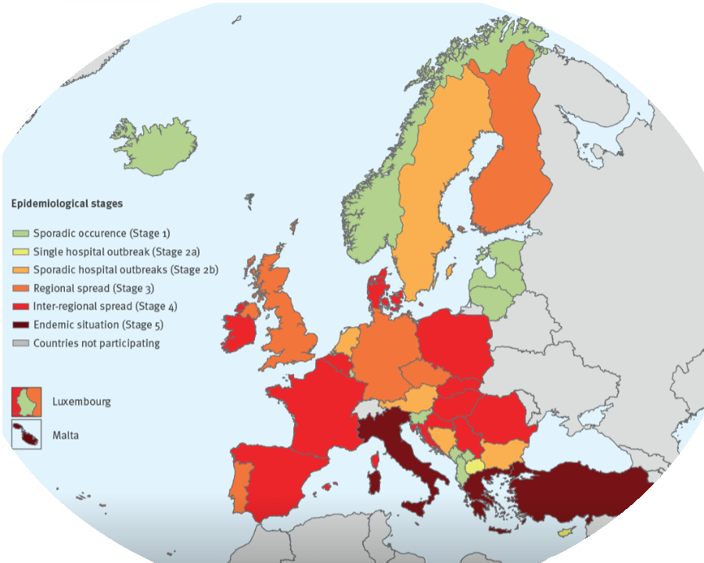
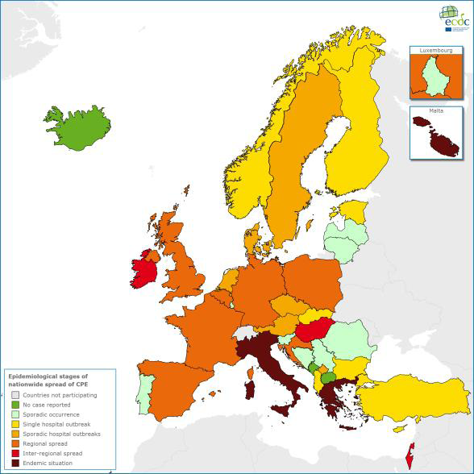
resistance is getting worse
Carbapenem-resistant Enterobacterales
Carbapenem-resistant Enterobacterales
2013
2018
https://ecdc.europa.eu/sites/portal/files/media/en/publications/Publications/carbapenem-resistant-enterobacteriaceae-risk-assessment-april-2016.pdf
Notes:
This graph shows Carbapenemase producing Enterobacteriaceae (CPE) becoming more prevalent in Europe over a short period of time. Enterobacteriaceae has been renamed Enterobacterales.
References:
https://ecdc.europa.eu/sites/portal/files/media/en/publications/Publications/carbapenem-resistant-enterobacteriaceae-risk-assessment-april-2016.pdf
https://www.ecdc.europa.eu/sites/default/files/documents/carbapenem-resistant-enterobacteriaceae-risk-assessment-rev-2.pdf

Slide 8
WHERE?
Notes:
Do not think it is limited to high income countries, rather it is a global issue which is worse in low and middle income countries where several factors enhance the development of AMR

Slide 9
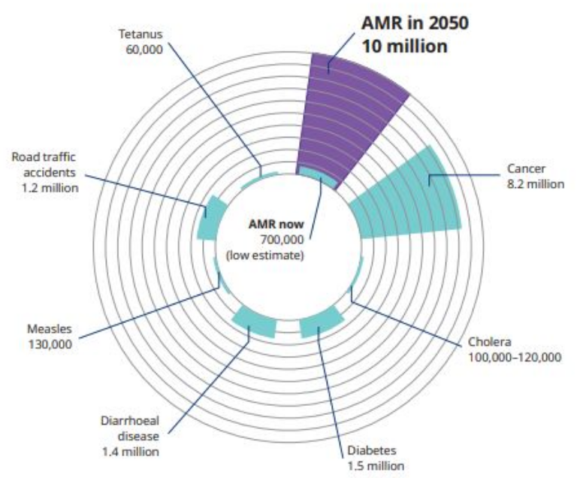
Antimicrobial Resistance
Deaths attributable to AMR annually, and by 2050 [O’Neill Review 2016]
Notes:
It is reported that bacteria resistant to current antibiotics cause more than 750,000 deaths worldwide every year, this includes 230,000 deaths from multidrug-resistant tuberculosis. Without any action to stop the spread of resistance, it is predicted that this number will rise to 10 million deaths per year by 2050. The economic burden from increasing resistance is estimated to cost about $100 trillion globally by 2050.
References:
https://www.researchgate.net/figure/Total-deaths-projected-by-2050-attributable-to-antimicrobial-resistance-AMR-every-year_fig2_340990507
Wozniak T, Nguyen A, Rollin A, Brock J, Bowskill A, Morgan B, et al. Antimicrobial Resistance (AMR) Impact Report: How big is Australia’s AMR threat? Australia: CSIRO and MTPConnect; 2022.
Organisation for Economic Co-operation and Development. Stemming the superbug tide: just a few dollars more. Paris: OECD, 2018.

Slide 10
Nigeria: Data on AMR
Nwadike et al reported that all Acinetobacter baumanii isolated from an ICU in Ibadan were resistant to amoxicillin-clavulanate, ampicillin-sulbactam, ciprofloxacin, ofloxacin, ceftriaxone, and gentamicin (Nwadike et al., 2014)
Prevalence of Multidrug-resistant organisms(MDRO) among ICU patients in Ibadan was 59.3%, with MDR E. coli and MDR Klebsiella spp. accounting for the highest MDROs. Resistance to cefuroxime was 92.9%. (Makanjuola et al., 2018)
Among patients with neonatal sepsis in Nnewi, 61.5% of S. aureus isolated were MRSA, 66.7% of Klebsiella pneumoniae and 66.7% of Acinetobacter baumanii isolated were MDR (Nnamani et al., 2022)
Among isolates from patients with sepsis, 86.6%, 77.2% of Enterobacterales isolated were resistant to amoxicillin, and amoxicillin-clavulanate respectively while 91%, 83.8%, 82.3% and 70.6%% of the non-fermentative bacteria were resistant to nitrofurantoin, doxycycline, co-trimoxazole and ticarcillin-clavulanate. (Olowo-okere et al., 2020)

Slide 11
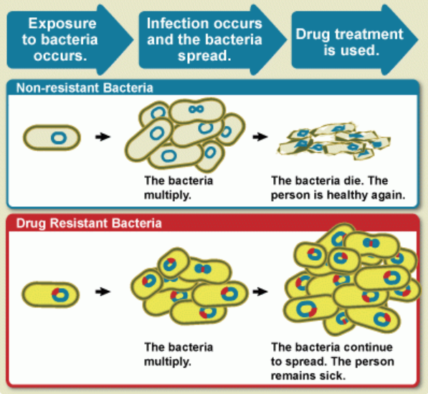
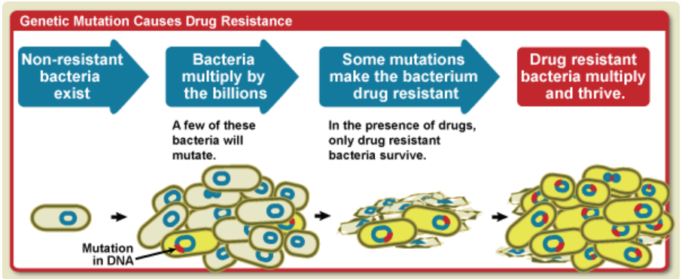
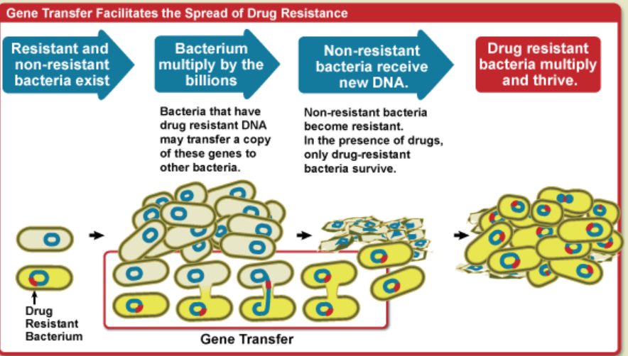
How DOES AMR OCCUR?
AMR is a natural phenomenon
https://www.niaid.nih.gov/research/antimicrobial-resistance-causes
Notes:
AMR occurs naturally
Antibiotics naturally kill bacteria. Occasionally, a few bacteria mutate in the course of its multiplication and becomes resistant to the antibiotic, Thereby making the antibiotic ineffective against it. Bacteria with the mutated gene can transfer it to another bacteria resulting in resistance in the other bacteria

Slide 12
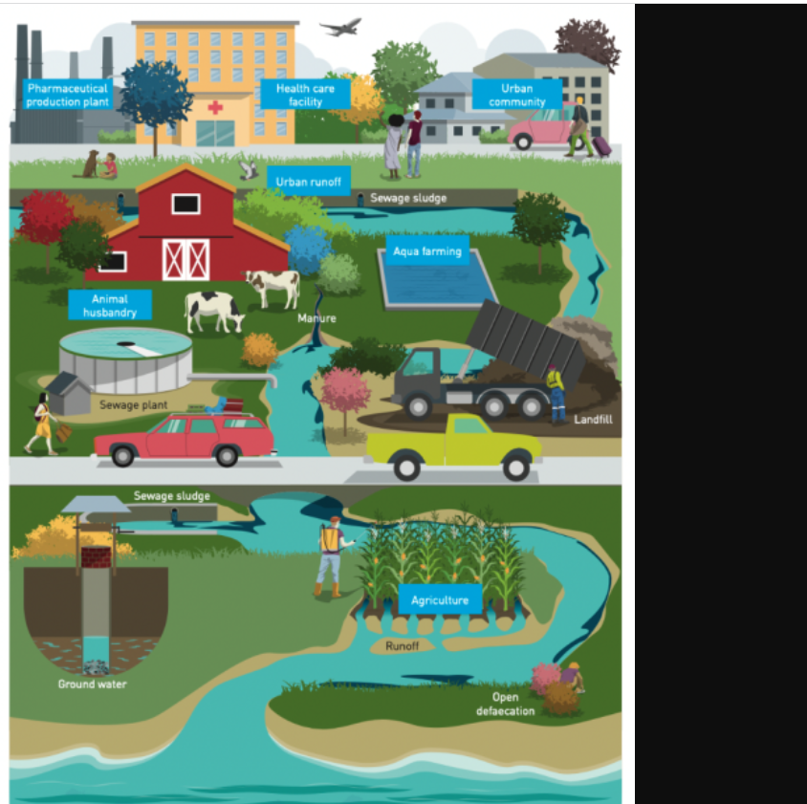
AMR occurs naturally but it is accelerated by overuse, misuse and inappropriate use of antibiotics
This can occur in different sectors: human health, agriculture (animals and poultry), environment
Notes:
AMR occurs naturally
However, it is worsened by the overuse, misuse of antimicrobial agents among others
In the human health sector, in agriculture (poultry, fish farming, animal husbandry) and in the environment (due to disposal and runoff into water bodies resulting in pollution) .

Slide 13
Factors contributing to AMR
Environmental
Overcrowding
Widespread use of antibiotics in animal husbandry and agriculture
Drug-related
Fake drugs
Substandard drugs
Patient-related
Self-medication
Lack of education
Poor sanitation
Increasing travel
Increasing use of antibiotics
Easy access to antimicrobials
Misconception
Poverty
Prescriber-related
Inappropriate use
Overuse
Inadequate dosing
Polypharmacy
Obsolete knowlege
Sharing of antimicrobials
Poor-adherence to dosage
Notes:
Factors can be divided into 4 groups
Environmental, drug-related, patient-related and prescriber/doctor-related factors
Overcrowding, poor sanitation, increasing travel encourage the spread of AMR. Widespread use in agriculture and animal husbandry encourage the development of AMR

Slide 14
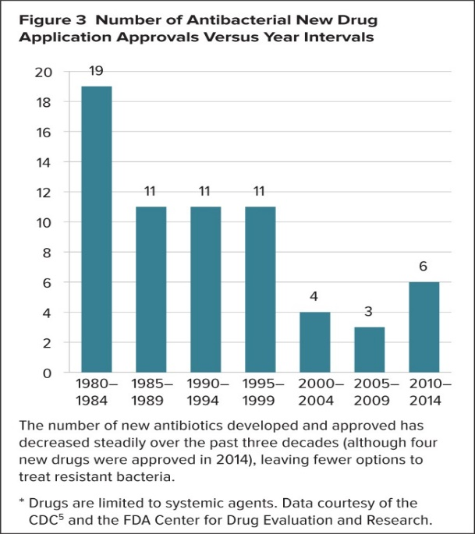
Decline in antibiotic production
Very few antibiotics have been developed in the last 20 years
Most ‘new’ antibiotics are variations of existing antibiotics
Only 5 novel classes have been developed in the last 20 years.
Notes:
So why can’t new antibiotics be developed to tackle resistance? Well they can but there are reasons why this is a very slow and complex process.
Many pharmaceutical companies have stopped developing antibiotics over the last 20 years, resulting in very few new antibiotics being developed and released onto the market. The reason for this decline is that antibiotics, in particular, are extremely expensive and resource-intensive to develop.
The World Health Organisation reviewed the publically available information on the current clinical development pipeline of antimicrobial agents. Their review showed the current clinical pipeline is still insufficient to mitigate the threat of antimicrobial resistance (particularly Gram-negative bacteria and TB). And most agents in the pipeline are modifications of existing antibiotic classes – therefore they are only short term solutions as they usually cannot overcome multiple existing resistance mechanisms.
References
Lee Ventola C. The Antibiotic Resistance Crisis Part 1: Causes and Threats. P T 2015 Apr; 40(4): 277–283 https://www.ncbi.nlm.nih.gov/pmc/articles/PMC4378521/

Slide 15
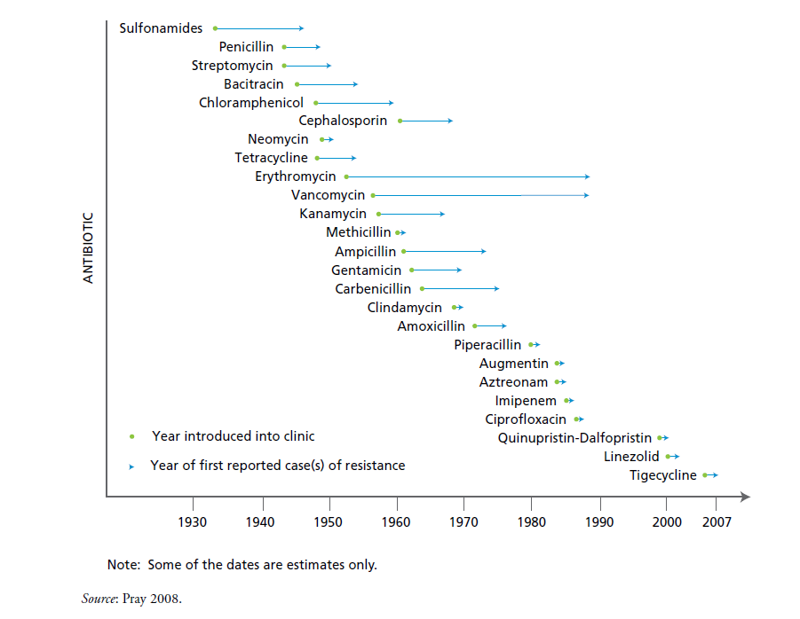
Antimicrobial Resistance
Notes:
A graph illustrating the timeline between introduction of antibiotics and the development of resistance.
Resistance to some antibiotics developed in less than 5 years of the introduction of the antibiotic
References:
FIP Fighting Antimicrobial Resistance - https://www.fip.org/file/163
ANTIBACTERIAL AGENTS IN CLINICAL DEVELOPMENT - An analysis of the antibacterial clinical development pipeline, including tuberculosis (http://apps.who.int/iris/bitstream/10665/258965/1/WHO-EMP-IAU-2017.11-eng.pdf?ua=1 )

Slide 16
Prevention and control of AMR
World Health Organization (WHO): launched GLASS, AWARE classification of antibiotics and WAAW
United nations (UN): one health approach
European union (EU): European antibiotic awareness day, ban on preventive mass medication of antimicrobials in animals
Nigeria: establishment of the national action plan on AMR, antimicrobial stewardship program
Notes:
Globally there have been widespread actions to curb AMR. ran
GLASS: Global antimicrobial resistance and use surveillance system: to monitor AMR across member states
AWARE classification: to categorize antibiotics into groups (access, watch and reserve) to emphasize the significance of their appropriate use while also taking into account the impact of the various classes of antibiotics on resistance
WAAW: World antimicrobial resistance awareness week (WAAW) aimed at improving the awareness and understanding of antimicrobial resistance by encouraging prudent use of antimicrobial agents. It is celebrated globally from the 18-24 November annually. Also the establishment of antimicrobial stewardship programs which promotes rational and prudent use of antibiotics in hospitals was introduced
UN: The Food and Agriculture Organization of the United Nations (FAO), the UN Environment Programme (UNEP), the World Health Organization (WHO) and the World Organisation for Animal Health (WOAH) work together in a bid to combat the emergence and spread of AMR in the 3 sectors

Slide 17
What can you do?
Don’t use antimicrobials without prescription
Always complete the full treatment of antibiotics
Do not share or use leftover antibiotics
Adhere strictly to instructions when using antimicrobials
Prevent infections by improving hygiene
Notes:
Do not demand for antibiotics when it is not needed
Do not self-medicate

Slide 18
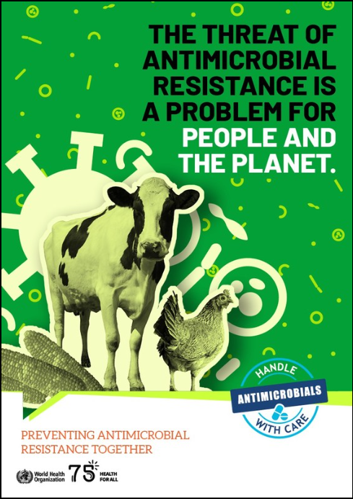
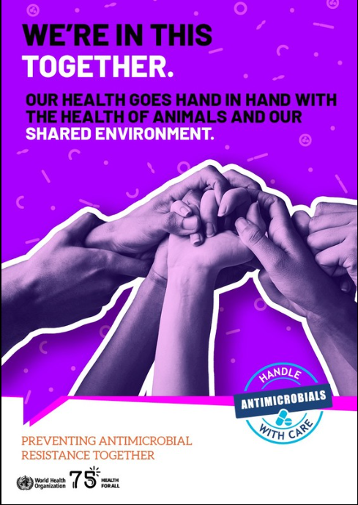
WHY

Slide 19
We all have a role to play
Let’s keep our antimicrobials working and save lives
The future of antimicrobials depends on ALL of us
Join the conversation:
#WAAW2023
#WorldAMRAwarenessWeek
#2023WorldAMRWeek
#AMRactionNG
Notes:
We all have a role to play, let’s do what we can in our corner and spread the message

Slide 20
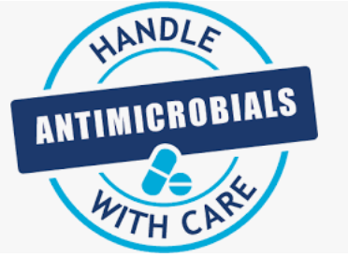
Notes:
In summary, I will implore you to join us in preventing AMR together by handling antimicrobials with care

Slide 21
References
Ashley E., Bielicki J., Carvalheiro C., Dunachie S., Haselbeck A. et al. (2022) Global burden of bacterial antimicrobial res??stance in 2019: a systematic analysis. The Lancet. 399(10325):P625-655
Makanjola OB., Fayemiwo SA., Okesola AO., Gbaja A., Ogunleye VO., Keinde AO., Bakare RA. (2018) Pattern of multidrug resistant bacteria associated with intensive care unit infections in Ibadan, Nigeria. Annals of Ibadan Postgraduate Medicine. 16(2):162-169
Nnamani KO., Nnamani CP., Iloh KK., Aghanya I., Ushie S., et al (2022) Bacterial isolates, antibiogram and outcomes of blood culture proven sepsis in neonates at a tertiary institution in South East Nigeria: a cross-sectional study. Therapeutic advances in Infectious Diseases. 9:204993612211224
Nwadike VU., Ojide CK., Kalu EI. (2014) Multidrug resistant acinetobacter infection and their antimicrobial susceptibility pattern in a nigerian tertiary hospital ICU. African Journal of Ifectious Diseases. 8(1): 14-18
National Institute of Allergy and Infectious Diseases Antimicrobial (drug) resistance [Assessed 12 November, 2023] Available at https://www.niaid.nih.gov/research/antimicrobial-resistance
Olowo-okeree A., Ibrahim YKE., Nabti LZ., Olayinka BO. (2020) High prevalence of multridrug-resistant Gram-negative bacterial infections in Northwest Nigeria. Germs 10(4): 310-321
World Health Organization. (2022) World leaders and experts call for action to protect the environment from antimicrobial pollution. [Assessed 12 November, 2023] Available at https://www.who.int/news/item/02-03-2022-world-leaders-and-experts-call-for-action-to-protect-the-environment-from-antimicrobial-pollution
World Health Organization. World AMR Awareness Week 2023-Campaign Guide [Assessed 12 November, 2023] Available at https://www.who.int/publications/m/item/world-amr-awareness-week-2023-campaign-guide
World Health Organization. World AMR Awareness Week 2023 [Assessed 12 November, 2023] Available at https://www.who.int/campaigns/world-antimicrobial-awareness-week

Slide 22
Thank you for your attention

Slide 23
ANTIBIOTIC RESISTANCE IN FOOD ANIMAL PRODUCTION SYSTEMS
BY
DR AYODEJI O. OLARINMOYE
D.V.M, M.P.V.M, Ph.D. [Ibadan, Nigeria ], MPH [LLU, USA]

Slide 24
ANTIBIOTIC RESISTANCE: KEY DEFINITIONS
Antibiotic: a drug that can inhibit the growth of or destroy microorganisms.
Antibiotic Resistance: A phenomenon characterized by the ability of a microorganism to resist (i.e. tolerate and survive) therapeutic concentrations of antibiotic preparations.
Organisms resistant to a minimum of three classes of antibiotics are regarded as Multi-drug Resistant (MDR) strains or phenotypes.

Slide 25
Sources of Antibiotic Resistance Organisms in Food Animals
Selection pressure for development of MDR plasmids is driven by the routine addition of antibiotics to animal feed and water for disease prevention and growth promotion (Bager et al., 1997; Van den Bogaard & Stobberingh, 1999).
Trend of heavier usage and misuse of human antibiotics as poultry medications in Nigeria [Okoli et al., 2002; Olarinmoye et al., 2013]
Nigerian farmers routinely administer antibiotics (atimes human-veterinary antibiotics combos) to sick animals [Alhaji & Isola, 2018; Olarinmoye et al., 2013].
Animal feeds contaminated with MDR bacteria (Okonko et al., 2010; Ezekiel et al., 2011).

Slide 26
GRIM STATS [South-West Nigeria]
Avian Pathogenic Escherichia Coli [APEC] isolates from across SW Nigeria found to be highly resistant to Amoxicillin (99.2%), Chloramphenicol (96.5%), Tetracycline (91.4%), and Ofloxacin (86.4%); and moderately resistant to Gentamicin (67.2%), Augmentin (63.5%), Nitrofurantoin (51.7%), [Olarinmoye et al., 2013]
Worrisome that 14.3% of the APEC isolates were resistant to 200 μg of Str. (10X the rec26ommended disc concentration for Kirby-Bauer gel diffusion test) were resistant [Olarinmoye et al., 2013].
Overall 84.68% (431/509) of APEC isolates from SW Nigeria were MDR phenotypes; one-third of all the isolates (33.22%, 169/509 isolates) were pan-resistant to all the afore-mentioned antibiotics [Olarinmoye et al. 2013].
Prevalence of E. coli and MDR E. coli at the Live Bird Market level were 80% and 56.3%, respectively; Notably high resistance rates observed for Ceftazidime (96.9%) and Imipenem (90.6%) and odds of MDR E. coli increased eight-fold in poultry kept by Live Bird Sellers who use antibiotics as prophylaxis [Adebowale et al., 2022]
High prevalence rate of MDR bacteria resistant to Oxyetracycline (94.34%) detected in fishes and attributed to abuse of the drug in fish farming [Oladele et al. 2021].

Slide 27
Occurrence of MDR Bacteria in Food Animal Production Systems: Veterinary and Economic Implications
Higher morbidities
Need for prolonged treatment of sick animals
Higher treatment failure rates and mortalities
Costly drug changes that add to production costs for meat, dairy and eggs and lower farmers’ profits.

Slide 28
The Public Health Consequences
MDR bacteria spill-overs into the human food chain could have grave public health implications ̶
MDR bacteria may select for drug resistant zoonotic bacteria such as Salmonella and Campylobacter.
MDR bacteria cause higher morbidities, prolonged hospitalizations, the need for use of newer and expensive drugs, and greater risk of mortalities in the elderly and infants.

Slide 29
Prevention and Control
Holistic approach needed; active involvement and cooperation of farmers, hatchery operators, drug importers and marketers, veterinary/allied professionals, and government regulatory agencies at all levels;
Mass awareness campaigns by vet extension agencies to sensitize poultry and livestock farmers and feed millers on benefits of rational administration of antibiotics to farm animals;
Stricter enforcement of extant laws. Section 6.23 (Sub-section 5) of the National Drug Policy requires vet drugs to be dispensed based only on prescriptions given by authorized and registered veterinary practitioners in Nigeria;
Research into nutraceuticals (medicinal plants) as alternatives to antibiotics in animal nutrition and production (Olumide et al 2022 a & b; Ajibade et al. 2023; Akintunde et al, 2023).

Slide 30
Thank you for listening

Slide 31
References
Adebowale, O., Makanjuola, M., Bankole, N., Olasoju, M., Alamu, A., Kperegbeyi, E., ... & Fasina, F. O. (2022). Multi-drug resistant Escherichia coli, biosecurity and anti-microbial use in live bird markets, Abeokuta, Nigeria. Antibiotics, 11(2), 253.
Akintunde, A. O., Ndubuisi-Ogbonna, L. C., Olorunfemi, O. A., Ladele, M. M., Shobo, B. A., Adewole, S. A., & Akinboye, O. E. (2023). Nutritional and Ethno-Medicinal Potentials of Egg-Lime-Molasses Mixture in Livestock Production. Asian Journal of Dairy & Food Research, 42(3).
Ajibade, O., Tayo, G. O., Olumide, M. D., & Akintunde, A. O. (2023). Effect of Centella asiatica as feed additive on blood profile, egg quality and gut microbial contents of ISA brown laying birds. Aceh Journal of Animal Science, 8(3), 87-94.
Alhaji, N. B., & Isola, T. O. (2018). Antimicrobial usage by pastoralists in food animals in North-central Nigeria: The associated socio-cultural drivers for antimicrobials misuse and public health implications. One Health, 6, 41-47.
Ezekiel, C. N., Olarinmoye, A. O., Oyinloye, J. M. A., Olaoye, O. B., & Edun, A. O. (2011). Distribution, antibiogram and multidrug resistance in Enterobacteriaceae from commercial poultry feeds in Nigeria. Afr j microbiol res, 5(3), 294-301.
National Drug Policy (2003). Control of Veterinary Drugs (First Revision). Federal Ministry of Health Nigeria in Collaboration with World Health Organization, Geneva. pp. 30-31.
Oladele, O. O., Olarinmoye, A. O., Ntiwunka, U. G., & Akintomide, T. O. (2015). Survey of bacterial isolates from cases of fish disease outbreaks and their antibiotic susceptibility patterns. Nigerian Journal of Fisheries, 12(2), 901-906.
Olarinmoye, A.O., Oladele, O.O., Adediji, A.A., Ntiwunka, U.G. and Tayo, G.O. (2013). Antibiograms of avian pathogenic Escherichia coli isolates from commercial layers with colibacillosis in southwest Nigeria. Malaysian Journal of Microbiology 9(4):317-325. DOI: 10.21161/mjm.53013
Olumide, M. D., Akintunde, A. O., & Kolu, P. (2022a). Response of broiler chickens to substitution of vitamin-mineral premix with Carica papaya seed meal. Journal of the Indonesian Tropical Animal Agriculture, 47(3), 215-234.
Olumide, M. D., Akintunde, A. O., Ndubuisi-Ogbonna, L. C., Shobo, B. A., Oreagba, T., & Isiadinso, I. (2022b). Nutritional and Ethnomedicinal Potentials of Parquetina nigrescens Leaf Extracts in Livestock Production. Tropical Animal Production Investigations, 25(1), 15-26.

Slide 32
IMPACT OF ANTIBIOTICS IN THE ENVIRONMENT
A PRESENTATION AT BABCOCK UNIVERSITY INTERDISCIPLINARY SEMINAR

Slide 33
SOURCES OF ANTIBIOTICS IN THE ENVIRONMENT
The formation of antibiotic residues in the environment is a result of different patterns of antibiotic use, which are often focused on treating bacterial illnesses and raising animals (Ben et al., 2019).
Report shows that antibiotic consumption pattern in animal husbandry is far higher than in human clinical setting (Polianciuc et al , 2020).
First global picture of antibiotic use was provided by Van Boeckel et al. in 2010 with an estimate of 63,151 tons and a projected increase by 67% in 2030 in BRICS countries (Brazil, Russia, India, China, and South Africa).

Slide 34
Figure 3: How Antibiotic drift to the Environment

Slide 35
IMPACT OF ANTIBIOTICS IN THE ENVIRONMENT
Effects on plants: Plants have the ability to absorb antibiotic residues, which may disrupt physiological functions and have ecotoxicological consequences.
Other effects include delay germination or reduce biomass, and consequently may negatively affect yield in farmland fertilized with contaminated manure.
Antibiotic Resistance: One of the most concerning effects is the promotion of antibiotic resistance. When antibiotics enter waterways or soil, they can lead to the development of resistant strains of bacteria.
This occurs as bacteria are exposed to low doses of antibiotics over time, allowing them to adapt and develop resistance mechanisms, which can spread to other bacteria, including those that cause diseases in humans.
(Polianciuc et al., 2020).

Slide 36
IMPACTS CON’T
Ecological Imbalance: Antibiotics can disrupt the natural balance of microorganisms in ecosystems. They can kill beneficial bacteria essential for various ecological processes, affecting nutrient cycles and potentially leading to imbalances in ecosystems.
Disruption of Microbial Communities: Antibiotics in the environment can harm microbial communities, affecting the diversity and composition of these communities. This can impact soil fertility, water purification processes, and overall ecosystem health. (Bielen et al., 2017).
Impact on Wildlife: Aquatic organisms, such as fish and amphibians, can be directly affected by antibiotics present in water bodies. These substances can accumulate in their tissues, affecting their health and potentially disrupting entire ecosystems.
Human Health Concerns: Although the direct impact on human health from environmental exposure to antibiotics is not fully understood, there are concerns about potential long-term effects. Antibiotic residues in water or food sources could contribute to the development of antibiotic-resistant infections in humans or affect human health in other ways.

Slide 37
MITIGATION BY ONE HEALTH APPROACH
Collaboration and Communication: One Health encourages collaboration among various sectors. Communication and data-sharing between these sectors are vital to understanding the emergence and transmission of MDR.
Surveillance and Monitoring: Surveillance systems need to track antimicrobial use and resistance patterns in humans, animals, and the environment. This helps identify trends and potential outbreaks, guiding the development of appropriate interventions.
Antimicrobial Stewardship: Promoting responsible use of antimicrobials in both human and veterinary medicine is crucial. This involves educating healthcare providers, veterinarians, farmers, and the public about proper antibiotic usage and the risks associated with misuse or overuse.

Slide 38
MITIGATION BY ONE HEALTH APPROACH
Environmental Impact: One Health involves assessing and mitigating environmental factors that foster the development and spread of MDR bacteria.
Research and Innovation: Encouraging research into new antimicrobials, alternative therapies, vaccines, and diagnostic tools is essential. Additionally, understanding the genetic mechanisms behind antimicrobial resistance in various settings helps in developing targeted interventions.
Policy Development: One Health informs the creation of policies and regulations. This can include guidelines for antibiotic use in agriculture, healthcare settings, and environmental regulations to control the release of antibiotics into ecosystems.
Public Engagement and Education: Raising awareness among the general public about the impact or consequences of improper antibiotic use.

Slide 39
CONCLUSION
By linking humans, animals and the environment, One Health can help to address the full spectrum of disease control – from prevention to detection, preparedness, response and management – and contribute to global health security.
The approach can be applied at the community, subnational, national, regional and global levels, and relies on shared and effective governance, communication, collaboration and coordination.
Having the One Health approach in place makes it easier for people to better understand the co-benefits, risks, trade-offs and opportunities to advance equitable and holistic solutions to health challenges.

Slide 40
REFERENCES
Ben Y, Fu C, Hu M, Liu L, Wong MH, Hung M, et al (2019). Human health risk assessment of antibiotic resistance associated with antibiotic residues in the environment: A review. Environ Res. 169:483–493.
Bielen A, Šimatović A, Kosić-Vukšić J, Senta I, Ahel M, Babić S, et al. (20170) Negative environmental impacts of antibioticcontaminated effluents from pharmaceutical industries. Water Res, 126:79–87.
Polianciuc, S.I, Gurzău, A.E, Kiss, B, Ștefan, M.G and Loghin, F (2020). Antibiotics in the environment: causes and consequences. Med. Pharm. Report, DOI: 10.15386/mpr-1742.
Van Boeckel TP, Brower C, Gilbert M, Grenfell BT, Levin SA, Robinson TP, et al. (2015). Global trends in antimicrobial use in food animals. Proc Natl Acad Sci U S A. 112:5649– 5654.

